Slide 1
Final Boss
Intro to Parallelization with Multithreading

Slide 2
Parallelization & Concurrency Definitions
Programs are executed on a system in one of two ways:
In Serial
In Parallel
Serial programs are what we have been writing all semester: every statement in our program is executed in order, top to bottom.
These programs are straightforward and simple.
Parallel programs have multiple pieces of code that are all executing simultaneously.
These programs can be much more complex!
Parallel program typically use multithreading, a common technique for achieving parallelism.

Slide 3
Parallelization & Concurrency Definitions
Concurrency refers to the ability to process multiple tasks over some span of time, but not necessarily at the same time.
Concurrency without parallelization uses context switching
e.g., I can tend to my garden and clean my yard, but never at the same time. I can go back and forth between the two tasks, but I do not need to finish one to start the other, and I can stop one to work on the other until they are both finished.
Concurrency with parallelization uses multithreading
e.g., I can cook a meal while talking on the phone, these are happening at the same time. I can easily do both at the same time, and it does not matter exactly the order in which I complete them.

Slide 4
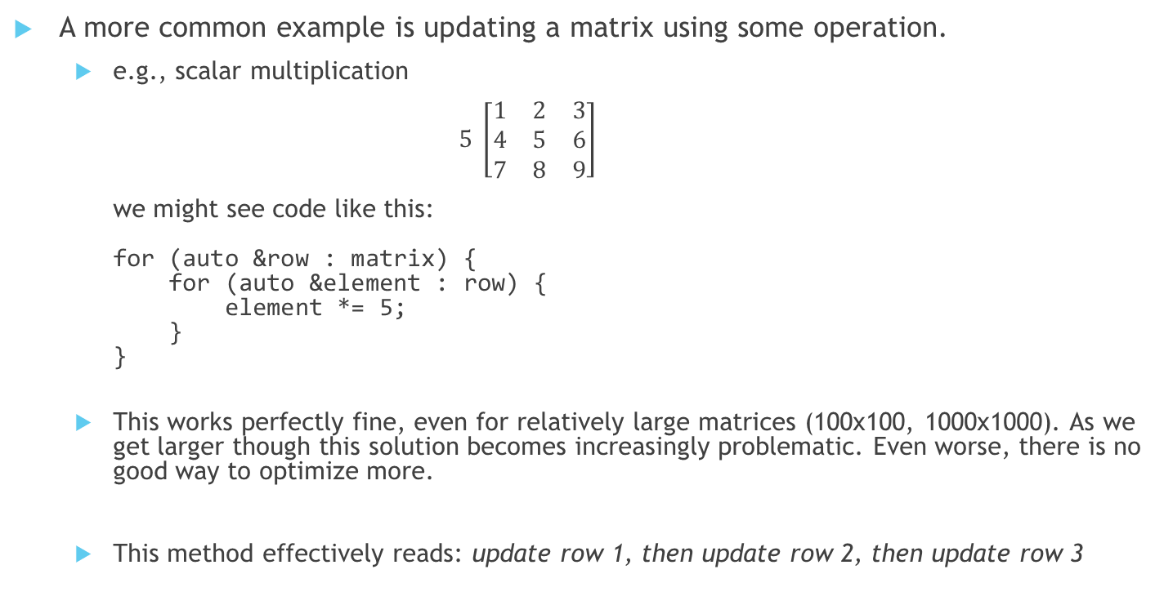
Parallelization
A more common example is updating a matrix using some operation.
e.g., scalar multiplication $5 \left[\begin{matrix}1 & 2 & 3 \\ 4 & 5 & 6 \\ 7 & 8 & 9\end{matrix}\right]$ we might see code like this: for (auto &row : matrix) { for (auto &element : row) { element *= 5; } }
This works perfectly fine, even for relatively large matrices (100x100, 1000x1000). As we get larger though this solution becomes increasingly problematic. Even worse, there is no good way to optimize more.
This method effectively reads: update row 1, then update row 2, then update row 3

Slide 5
Parallelization
Conceptually, it would be nicer if we could do the following tasks in parallel.
update row 1 while we also update rows 2 and 3
But how do we tell the computer to perform the update of row 1 while also updating rows 2 and 3... all simultaneously?
We use threads. As we execute a program, think of the entire program as one long thread that accounts for all the code and functions and variables. We travel along the thread from start to finish. It is continuous and we cannot jump ahead. Our thread though can split and unwind a little, allowing multiple tasks to be carried out at once.

Slide 6
Parallelization
Serial Execution
Parallel Execution
Start
Start
These are called branches!
A
Single Threaded
Multi- Threaded
A
B
B
``
Finish
Finish

Slide 7
Multithreading
Multithreading is the process in which multiple processors are leveraged to execute multiple branches of code simultaneously.
The number of threads that can live concurrently is dependent on a combination of the hardware and operating system. We must differentiate between hardware and software threads!
Once a thread is created it begins running immediately. At this point the thread can be left alone to be joined later or it can be detached.
joining a thread halts the current thread to wait for the joining thread to finish.
detaching a thread separates the thread from the current thread altogether to finish on its own.

Slide 8
Multithreading
Threading in C++ on the surface just requires one new header: #include <thread>
There are others needed depending on the complexity of usage.
We create new threads using the std::thread object.
Its constructor takes in a function pointer and all the arguments for that function.
Once we create a thread, we can choose to detach it or hold onto it to join it later.

Slide 9
Example
#include <chrono>
#include <iostream>
#include <thread>
using namespace std::literals::chrono_literals;
auto foo() -> void {
std::this_thread::sleep_for(2s);
std::cout << "Thread #" << std::this_thread::get_id() << " done!"
<< std::endl;
}
auto main() -> int {
auto t1 = std::thread{foo};
auto t2 = std::thread{foo};
auto t3 = std::thread{foo};
t1.join();
t2.join();
t3.join();
}

Slide 10
Example Cont'd
Here is a possible output from our example:
Thread #2Thread #1 done!
done!Thread #3 done!

Slide 11
Example Cont'd
Here is a possible output from our example:
Our program is interleaving the output!
This is because std::cout is shared between all threads, and each line using it is broken down into multiple actions. Each usage of << is an individual action, even though it is part of a single statement!
We can resolve this by using a singular action to print!
Thread #2Thread #1 done!
done!Thread #3 done!

Slide 12
Example Cont'd
#include <chrono>
#include <thread>
#include <fmt/format.h>
#include <fmt/std.h>
using namespace std::literals::chrono_literals;
auto foo() -> void {
std::this_thread::sleep_for(2s);
fmt::print("Thread #{} done\n", std::this_thread::get_id());
}
auto main() -> int {
auto t1 = std::thread{foo};
auto t2 = std::thread{foo};
auto t3 = std::thread{foo};
t1.join();
t2.join();
t3.join();
}

Slide 13
Example Cont'd
Here is a possible output from our example:
Thread #2 done!
Thread #1 done!
Thread #3 done!

Slide 14
Example Cont'd
Here is a possible output from our example:
Why did thread #2 come before thread #1?
Starting threads is expensive and indeterministic!
Thread #2 done!
Thread #1 done!
Thread #3 done!

Slide 15
Multithreading Issues
Multithreading brings with it a brand-new set of issues when dealing with memory and timing.
What happens if one thread updates a variable as another one reads it? Does the second thread get the old or the new value? This is called a race condition.
When dealing with multiple threads we have ensure that we are sharing memory safely among them and properly synchronizing them.

Slide 16
Protecting Shared Memory
We can protect shared memory from improper access and usage using a mutex.
this is short for mutual exclusion
A thread locks a mutex while it performs some set of actions and all other threads must wait until the mutex is unlocked.
Threads are responsible for unlocking any mutex they lock, otherwise the program can experience a deadlock.
Every thread is waiting for a mutex to unlock and thus your program is frozen.
We must include the mutex header so that we can create std::mutex objects. When appropriate we must lock the mutex, and then unlock it.

Slide 17
Example
What is wrong here?
#include <mutex>
#include <thread>
#include <fmt/format.h>
auto m = std::mutex{}; // global, shared between
// all threads
auto foo() -> void {
m.lock();
fmt::print("all done!\n");
}
auto main() -> int {
auto t1 = std::thread{foo};
auto t2 = std::thread{foo};
auto t3 = std::thread{foo};
t1.join();
t2.join();
t3.join();
}

Slide 18
Example Cont'd
We never unlock our mutex!
One of the threads will acquire and lock m, but because it never unlocks it, the other threads will wait indefinitely for the lock to become available.
This is called a deadlock. They are bad.
What is wrong here?
#include <mutex>
#include <thread>
#include <fmt/format.h>
auto m = std::mutex{}; // global, shared between
// all threads
auto foo() -> void {
m.lock();
fmt::print("all done!\n");
}
auto main() -> int {
auto t1 = std::thread{foo};
auto t2 = std::thread{foo};
auto t3 = std::thread{foo};
t1.join();
t2.join();
t3.join();
}

Slide 19
Example Cont'd
We never unlock our mutex!
One of the threads will acquire and lock m, but because it never unlocks it, the other threads will wait indefinitely for the lock to become available.
This is called a deadlock. They are bad.
To fix this we can unlock the mutex!
What is wrong here?
#include <mutex>
#include <thread>
#include <fmt/format.h>
auto m = std::mutex{}; // global, shared between
// all threads
auto foo() -> void {
m.lock();
fmt::print("all done!\n");
m.unlock();
}
auto main() -> int {
auto t1 = std::thread{foo};
auto t2 = std::thread{foo};
auto t3 = std::thread{foo};
t1.join();
t2.join();
t3.join();
}

Slide 20
Protecting Shared Memory
When we want to use a mutex, we should also consider using a lock guard.
A lock guard is a special object that uses RAII to lock a mutex, and later unlock it when it goes out of scope.
RAII is a technique to automatically execute commands when objects go out of scope (like closing files, destructing stale memory, and yes, unlocking mutexes!)
Below we create a lock using a mutex; the lock handles locking and unlocking the mutex automatically! e.g., auto my_lock = std::lock_guard{m};
Here, my_lock will lock the mutex m until my_lock is deleted (goes out of scope).

Slide 21
Example
#include <chrono>
#include <mutex>
#include <thread>
#include <fmt/format.h>
using namespace std::literals::chrono_literals;
auto m = std::mutex{};
auto foo() -> void {
std::this_thread::sleep_for(2s);
auto lock = std::lock_guard{m};
std::cout << "Thread #" << std::this_thread::get_id() << " done!"
<< std::endl;
}
auto main() -> int {
auto t1 = std::thread{foo};
auto t2 = std::thread{foo};
auto t3 = std::thread{foo};
t1.join(); t2.join(); t3.join();
}

Slide 22
Example Cont'd
Here is a possible output from our example:
Thread #3 done!
Thread #2 done!
Thread #1 done!

Slide 23
Example
What's wrong here?
#include <thread>
#include <vector>
#include <fmt/format.h>
auto foo(std::vector<int> &d) -> void
{
d.push_back(1);
}
auto main() -> int
{
auto d = std::vector<int>{};
auto t1 = std::thread(foo, std::ref(d));
auto t2 = std::thread(foo, std::ref(d));
auto t3 = std::thread(foo, std::ref(d));
auto t4 = std::thread(foo, std::ref(d));
fmt::print("{}\n", fmt::join(d, ","));
}

Slide 24
Example
We have two race-conditions!
Every time we push back into the vector another push back could be happening, and if the vector is moving its data during a resize, we could end up losing data or putting data in an invalid location!
We do not ensure that our threads are complete before trying to read from the vector! We could still be writing to the vector!
#include <thread>
#include <vector>
#include <fmt/format.h>
auto foo(std::vector<int> &d) -> void
{
d.push_back(1);
}
auto main() -> int
{
auto d = std::vector<int>{};
auto t1 = std::thread(foo, std::ref(d));
auto t2 = std::thread(foo, std::ref(d));
auto t3 = std::thread(foo, std::ref(d));
auto t4 = std::thread(foo, std::ref(d));
fmt::print("{}\n", fmt::join(d, ","));
}

Slide 25
Protecting Shared Memory
Other ways we can protect our memory is to just be smarter.
Allocate/reserve memory ahead of time
Pass slices of objects that do not overlap
Do not mix reading and writing tasks on the same object(s)

Slide 26
Final Notes
Splitting a task into multiple threads does not guarantee a proportional reduction in runtime.
We must remember the limits of the system and hardware and understand the diminishing returns on adding more threads.
Too many people working the same task could ultimately make it take longer!
Simply starting a new thread requires tremendous system resources, which can mitigate the benefit in simple cases.
Your program is likely doing more work than its single threaded version, but that work is distributed and thus still completes more quickly.

